Slide 1
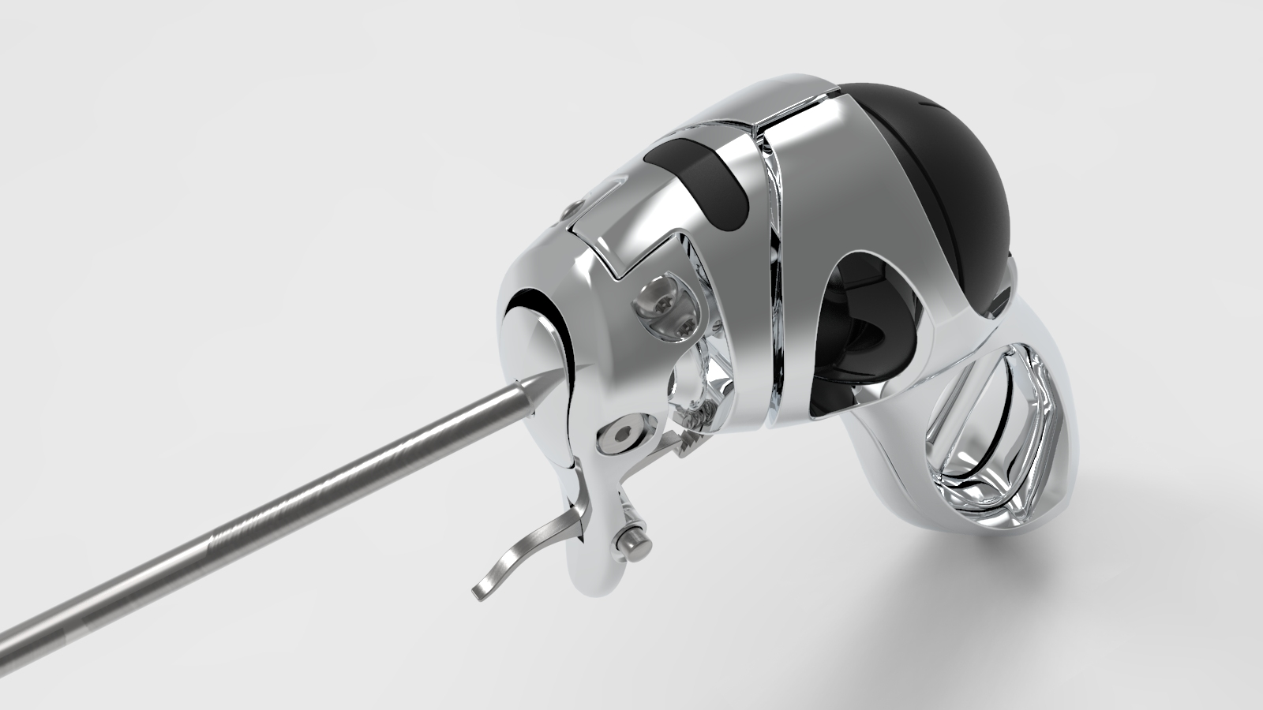


Intuitool Development Update
September 25, 2022

Slide 2



Overall Progress Overview
Preliminary designs for all requested unpowered tools have been completed.
A general configuration for the routing of power to end effectors has been conceptualized and a preliminary design created.
Final design of the powered end effectors is underway and expected to conclude in 3-4 weeks.
 | End Effector Type | Status
Manual | Scissors | Complete
 | Maryland Grasper | Complete
 | Blunt Grasper | Complete
 | Kelly Forceps | Complete
 | Atraumatic Grasper | Complete
 | Clip Applier | Complete
Powered | Scissors (Energy) | In Progress
 | Sealers (Energy) | In Progress
 | Hook Electrocautery | Pending Initiation
 | Spatula Electrocautery | Pending Initiation
 | Suction | Pending Initiation
Notes:
No cybersecurity, authentication, or cyber logging
Counterfeit process sensors have been discovered
Signal drift requires expensive recalibration
Leads to reliability, safety, and production issues
Presidential Executive Order #13920 issued to prevent FURTHER acquisition of hardware backdoors in Bulk Power company equipment

Slide 3

Manual Tools Overview
All new unpowered designs leverage the same base linkage design as the original Intuitool grasper to maximize modularity in manufacturing.
A related single articulation linkage is being designed for use with the powered vessel sealer and can be adapted to unpowered tool as well if desired.
Physical layout/geometries have been based on geometries and functionalities offered by existing competitors (i.e., Karl Storz, Stryker, etc.) to ensure comparable operation and user experience.
Fenestrated variants of relevant end effectors have been designed for more comprehensive usefulness.
Notes:
No cybersecurity, authentication, or cyber logging
Counterfeit process sensors have been discovered
Signal drift requires expensive recalibration
Leads to reliability, safety, and production issues
Presidential Executive Order #13920 issued to prevent FURTHER acquisition of hardware backdoors in Bulk Power company equipment

Slide 4
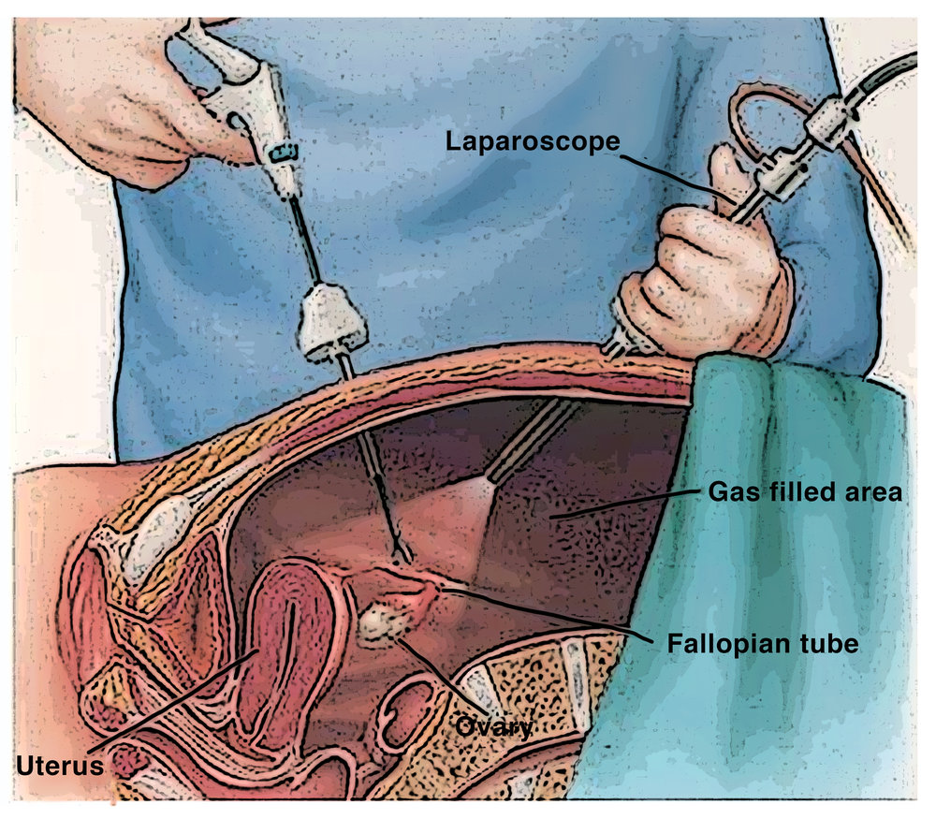

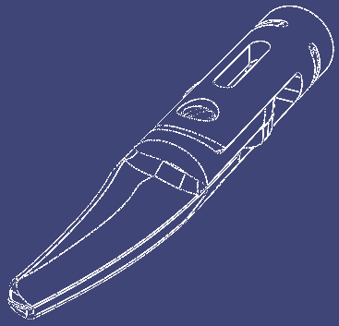
Manual Tools: Scissors
Currently designed as Metzenbaum scissors based on relative popularity relative to straight scissors
Cutting functionality is accomplished by rotating the end effector geometries 90 degrees to create a shear surface.
Based on estimated frequency of use, an initial offering length of 15mm has been selected. This is modeled parametrically and can easily be changed to match user preference.
Notes:
No cybersecurity, authentication, or cyber logging
Counterfeit process sensors have been discovered
Signal drift requires expensive recalibration
Leads to reliability, safety, and production issues
Presidential Executive Order #13920 issued to prevent FURTHER acquisition of hardware backdoors in Bulk Power company equipment

Slide 5
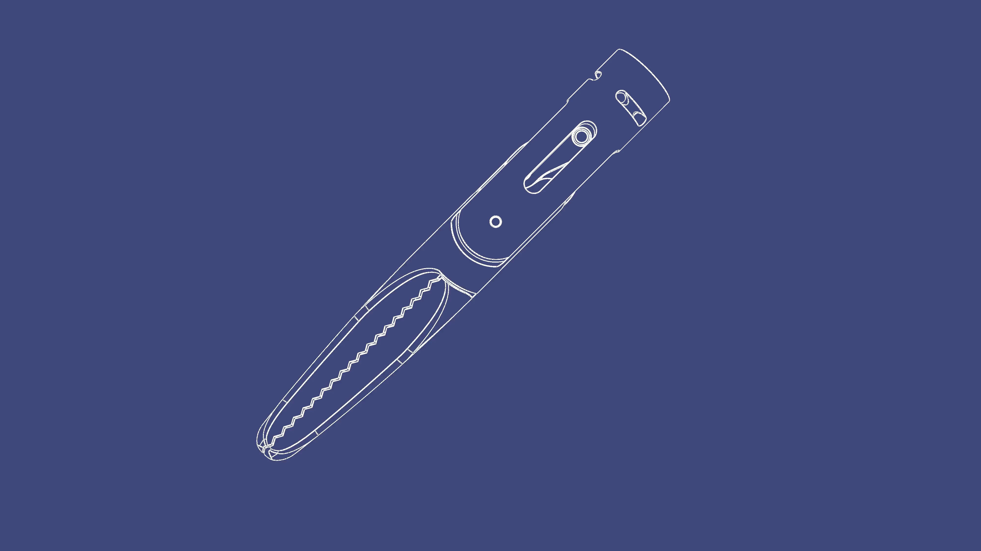
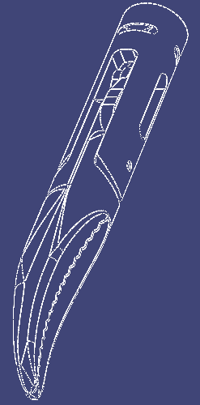
Manual Tools: Maryland Grasper
Maryland dissector geometry has been derived from the initial patent drawings for the tool (US5156633A) with some modifications to match current offerings:
17mm length Atraumatic splines | Pre-existing Intuitool linkage actuation
Notes:
No cybersecurity, authentication, or cyber logging
Counterfeit process sensors have been discovered
Signal drift requires expensive recalibration
Leads to reliability, safety, and production issues
Presidential Executive Order #13920 issued to prevent FURTHER acquisition of hardware backdoors in Bulk Power company equipment

Slide 6
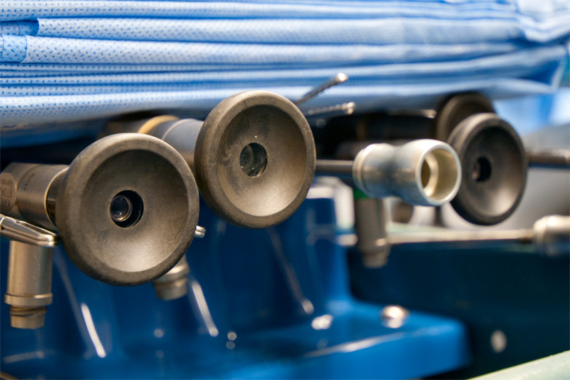
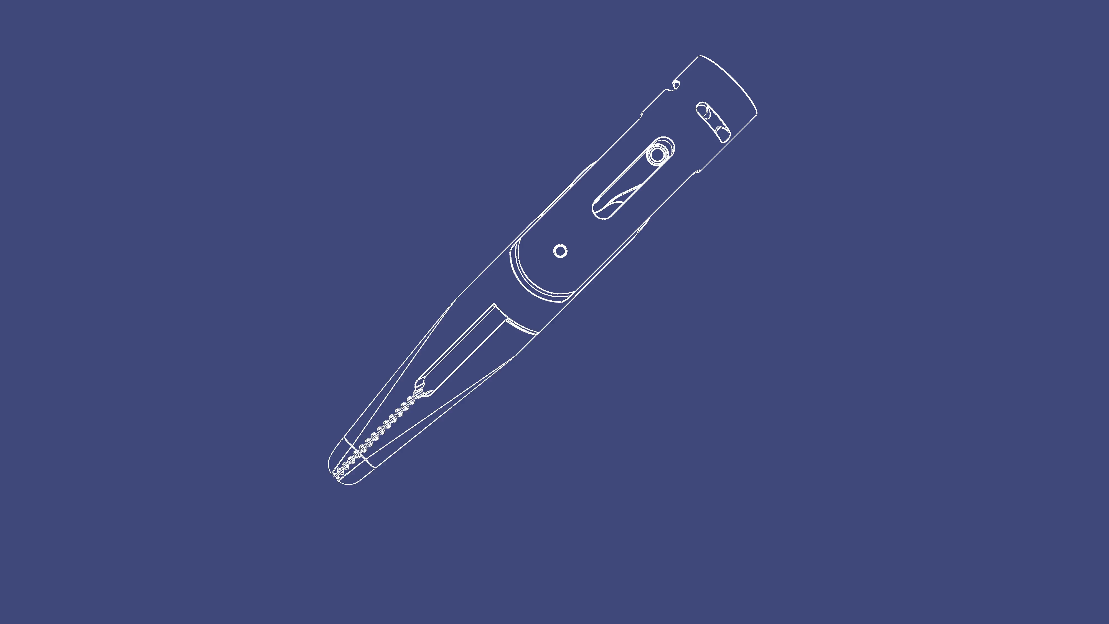
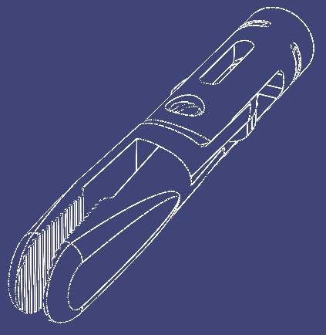
Manual Tools: Blunt Grasper
Currently designed as a duckbill effector due to apparent common usage
Designed with both standard and fenestrated variants.
Notes:
No cybersecurity, authentication, or cyber logging
Counterfeit process sensors have been discovered
Signal drift requires expensive recalibration
Leads to reliability, safety, and production issues
Presidential Executive Order #13920 issued to prevent FURTHER acquisition of hardware backdoors in Bulk Power company equipment

Slide 7



Manual Tools: Kelly Forceps
Kelly forceps geometry has been derived from the initial patent drawings for the tool (US5443480A) with some modifications to match current offerings:
17mm length
Atraumatic splines
Pre-existing Intuitool linkage actuation
Notes:
No cybersecurity, authentication, or cyber logging
Counterfeit process sensors have been discovered
Signal drift requires expensive recalibration
Leads to reliability, safety, and production issues
Presidential Executive Order #13920 issued to prevent FURTHER acquisition of hardware backdoors in Bulk Power company equipment

Slide 8

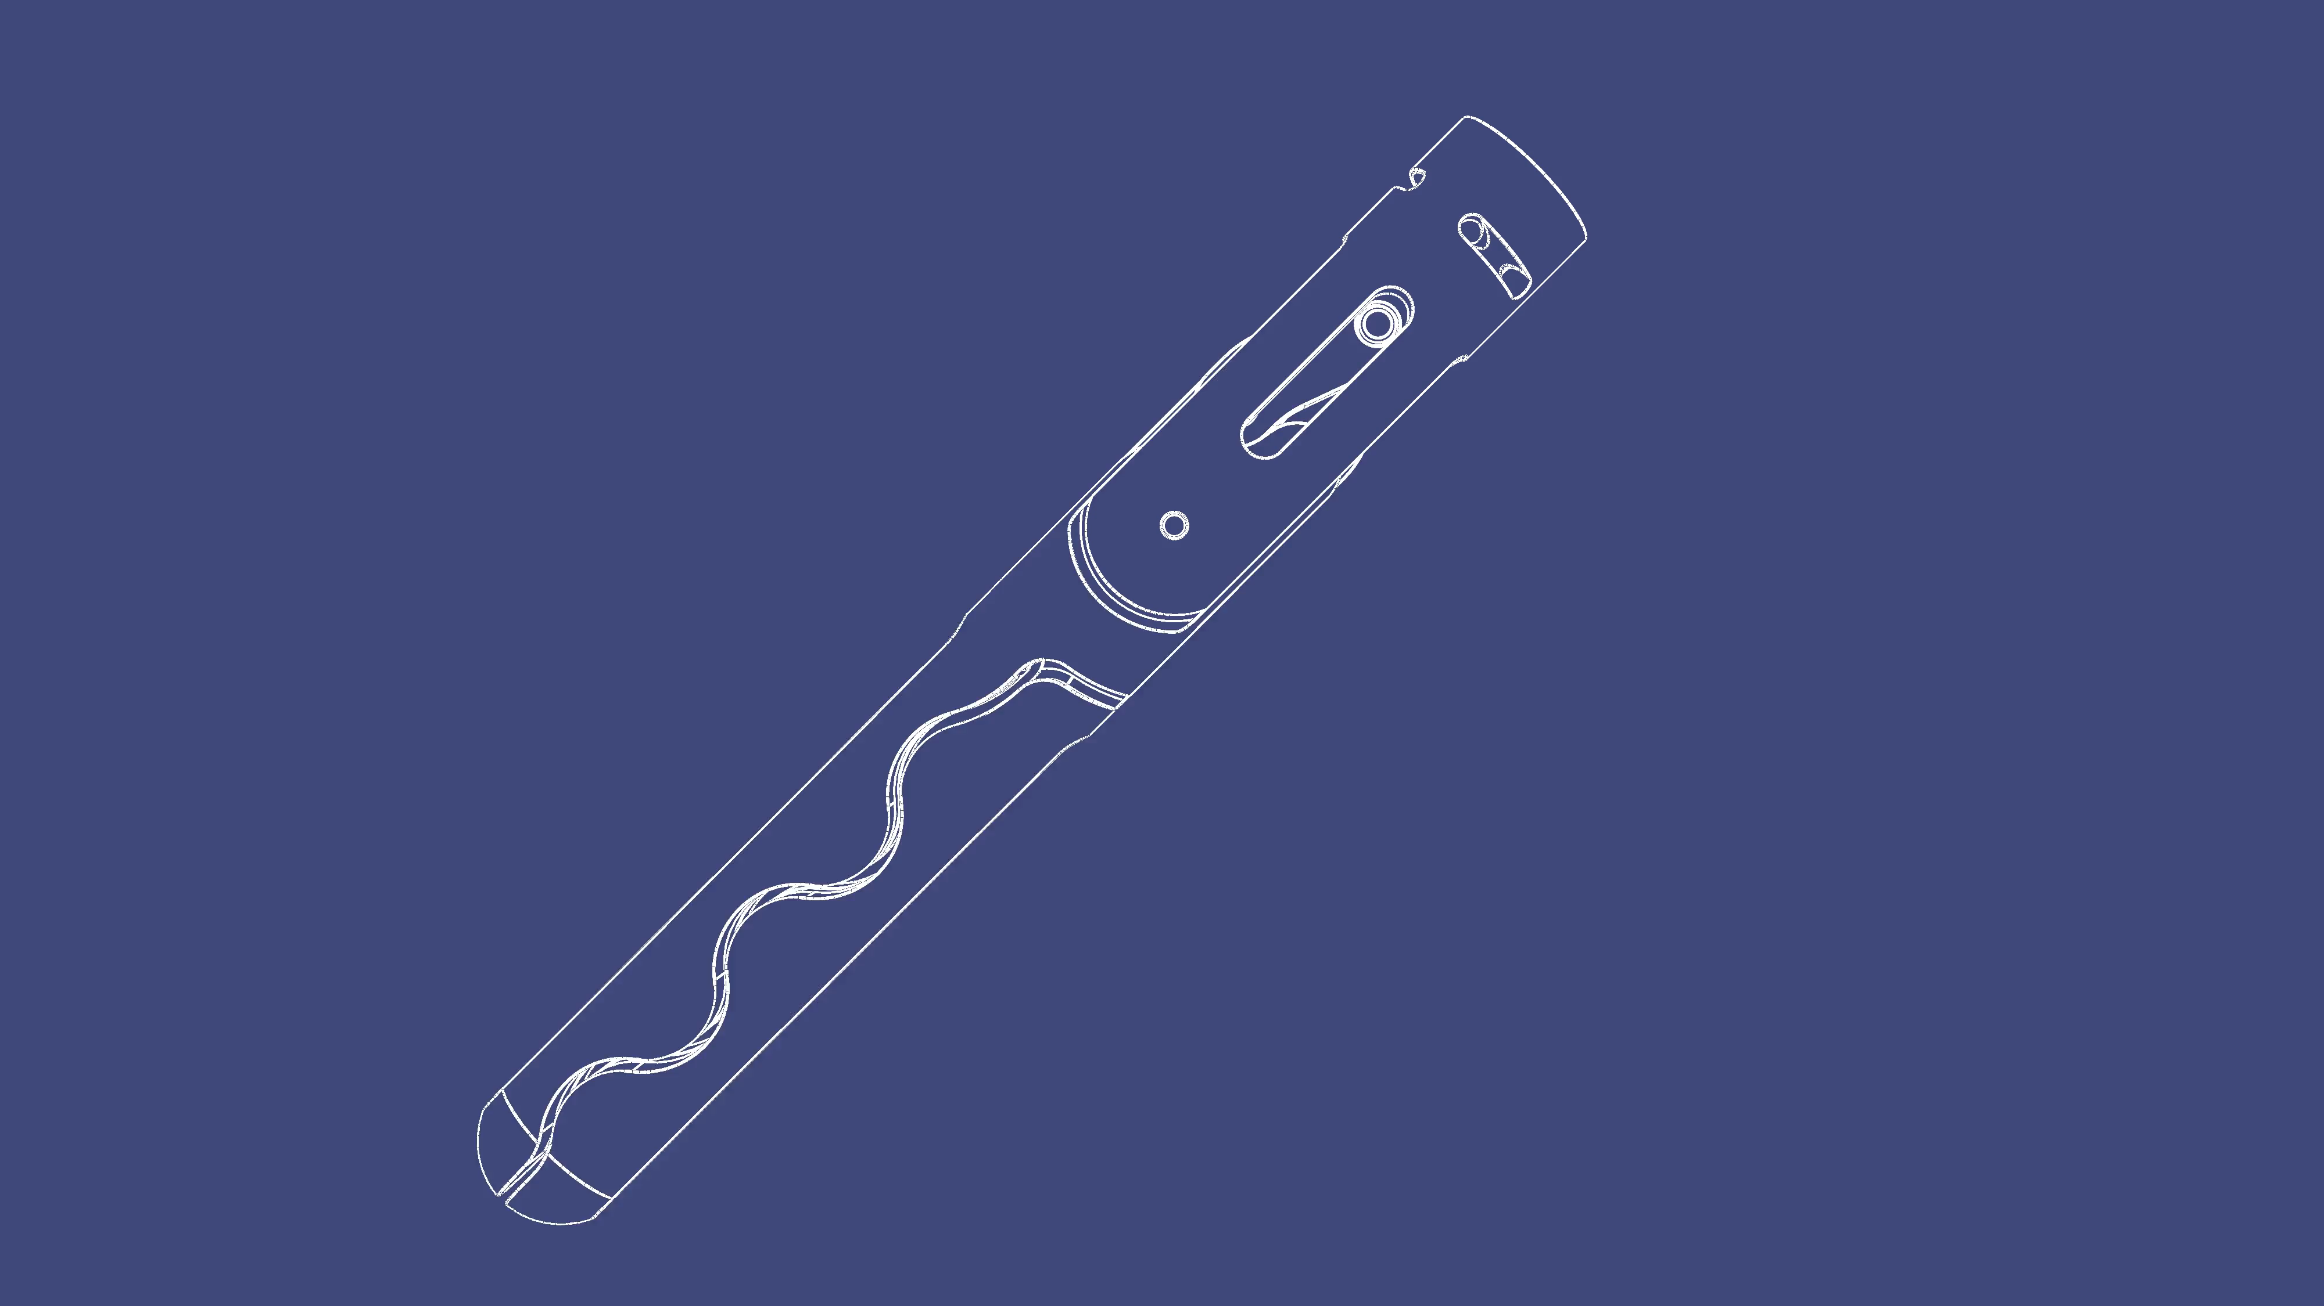
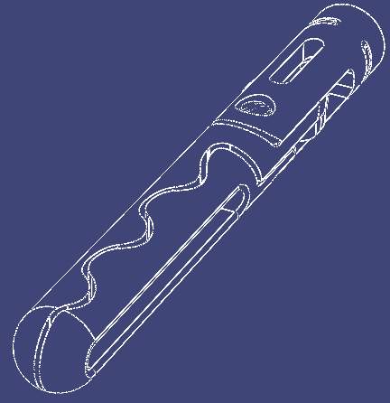
Manual Tools: Atraumatic Grasper
Directly adapted from pre-existing Intuitool R9 end effector due to presence of blunt tip and appropriate splines (course and wavy).
Currently designed at 22mm tool length to match original R9 layout.
Added fenestrated variant with parametric slot width to provide more possible use cases.
Notes:
No cybersecurity, authentication, or cyber logging
Counterfeit process sensors have been discovered
Signal drift requires expensive recalibration
Leads to reliability, safety, and production issues
Presidential Executive Order #13920 issued to prevent FURTHER acquisition of hardware backdoors in Bulk Power company equipment

Slide 9

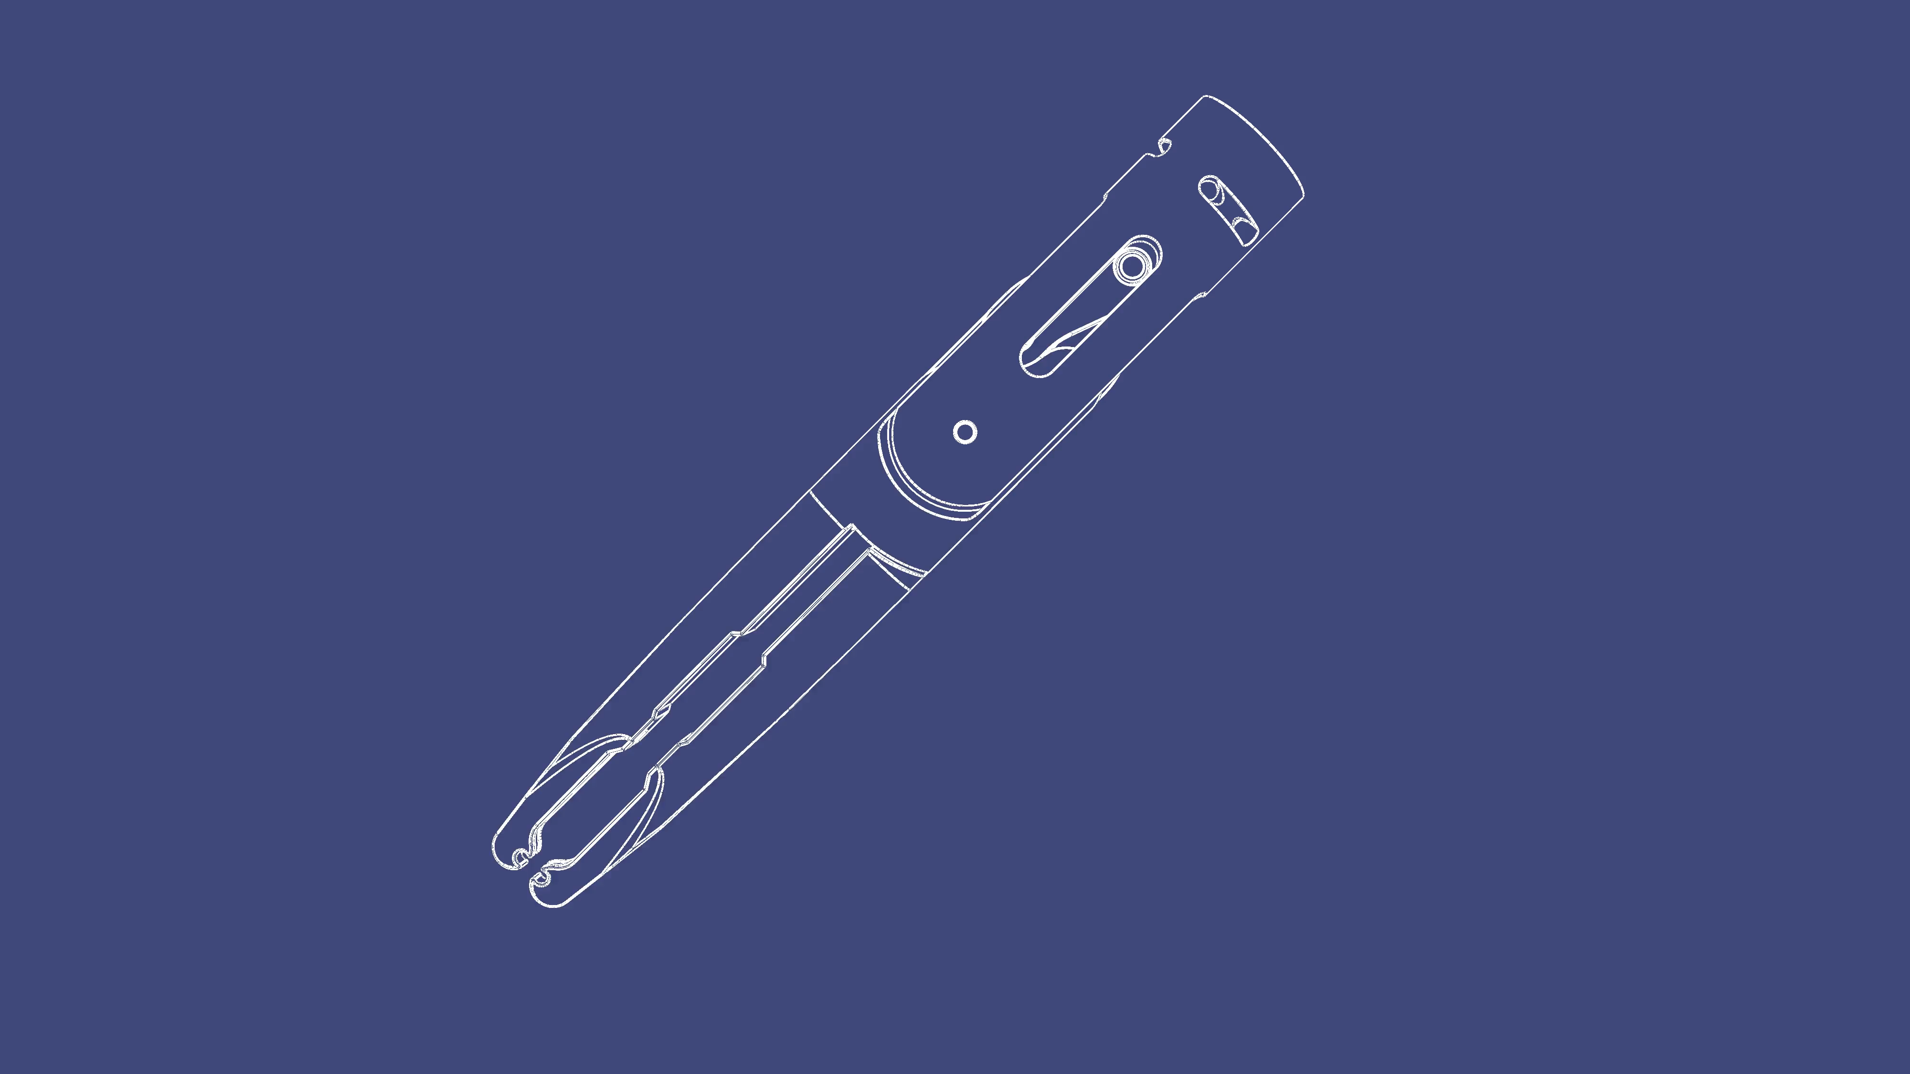

Manual Tools: Clip Applicator
Designed for compatibility with Grena Click’aV absorbable polymer ligating clips.
Selected due to readily available clip geometry information and utility.
Can be adapted to alternative clip geometries if desired.
Currently supports individual clip application due to existing active patents for reloading end effectors.
Notes:
No cybersecurity, authentication, or cyber logging
Counterfeit process sensors have been discovered
Signal drift requires expensive recalibration
Leads to reliability, safety, and production issues
Presidential Executive Order #13920 issued to prevent FURTHER acquisition of hardware backdoors in Bulk Power company equipment

Slide 10

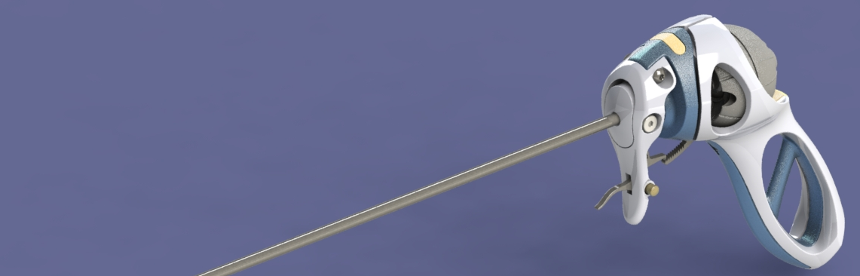
Device Modification Overview
No functional/structural changes have been implemented to the main assembly of the Intuitool to date, but several are proposed:
Spring-loaded quick release of the shaft assembly at the trigger actuation point
Eliminates the issue of loosening screws to remove shaft
Incorporation of power connectors for bipolar tools.
Incorporation of channels for the application of suction and irrigation.
Notes:
No cybersecurity, authentication, or cyber logging
Counterfeit process sensors have been discovered
Signal drift requires expensive recalibration
Leads to reliability, safety, and production issues
Presidential Executive Order #13920 issued to prevent FURTHER acquisition of hardware backdoors in Bulk Power company equipment

Slide 11
Power Routing Configuration
The current concept for power transmission within the device involves the installation of a bipolar electrode connector within the “core” of the handle
Internal leads for the bipolar connector are then routed to the fasteners holding the actuation bar for the end effector
The actuation bar is then treated as both a linkage member and as a means of power transmission comprising:
Two wire leads corresponding to positive and negative electrodes
A cylindrical insulator rod which improves actuation bar stiffness. and prevents electrical shorts and power leakage within the shaft
Two flat ring, or spade, connectors which transmit electricity directly to the end effector linkage.
Insulative coating (ceramic or polymer) to prevent power leakage away from the end effector mating surfaces.
Exposed metal mating surfaces of end effector to allow discharge into tissue between end effector mating surfaces.
Notes:
No cybersecurity, authentication, or cyber logging
Counterfeit process sensors have been discovered
Signal drift requires expensive recalibration
Leads to reliability, safety, and production issues
Presidential Executive Order #13920 issued to prevent FURTHER acquisition of hardware backdoors in Bulk Power company equipment

Slide 12
Powered Tools Overview
Powered versions of the scissors and the vessel sealer can be adapted from unpowered designs, with the inclusion of a co-molded or deposited insulative coating.
The powered vessel sealer will comprise a new single articulation linkage which can also be adapted for other desired tools (powered or unpowered).
Hook and spatula electrocautery are substantially different from the other devices and have not been substantially started to date as a result. These two tools will be modeled once the scissors and vessel sealer have been completed.
The incorporation of suction and irrigation into the design is still being conceptualized but is anticipated to take advantage of the ball joints used for articulation in the end of the probe, as well as channels in the insulator used for power transmission.
Notes:
No cybersecurity, authentication, or cyber logging
Counterfeit process sensors have been discovered
Signal drift requires expensive recalibration
Leads to reliability, safety, and production issues
Presidential Executive Order #13920 issued to prevent FURTHER acquisition of hardware backdoors in Bulk Power company equipment

Slide 13

Thank You

